Slide 1
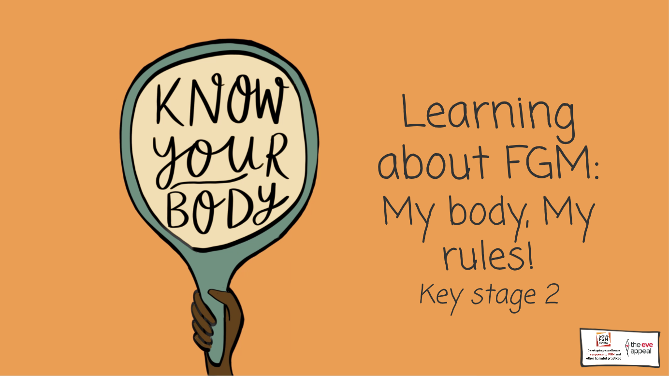

Slide 2
Notes:
Today we are learning about something incredibly important, and it’s called FGM – does anyone know what that stands for?
2-3 min Students to discuss in pairs what they think FGM is/stands for and do they think it goes against someone's rights?
Teacher to gather feedback

Slide 3
Notes:
Before we start to talk about this very important topic, it’s important that we establish a class agreement
Teacher to suggest some agreements including;
Safeguarding is the priority – if anything is spoken about that upsets a student or makes them feel anxious; that they have permission to step outside, and that they must speak to either teacher in the room or another trusted adult
Teacher to ask whether students would like to add any other agreements
Extra tip: Encourage students to see the lesson as a science lesson, and themselves as scientists

Slide 4
Notes:
Does anyone know what this stands for?
Teacher to encourage thought, by breaking down each letter

Slide 5
Notes:
It stands for the United Nations Convention on the Rights of the Child.
Teacher to ask class to say it back loudly, 2-3 times, and then ask students about what they think it means

Slide 6
Notes:
The UNCRC is a convention, which is like an agreement, between all of the world governments and the United Nations who have all promised to protect children. It has lots of articles (an article refers to a right you have) in it, 54 actually, which talk about lots of things, including children’s rights to have food, clean water, a place to live, and also how children should be protected from any form of harm too. All children have the same rights, and all rights are equal – meaning one right is not more important than another. Children cannot have their rights taken away from them.

Slide 7
Notes:
Name some other rights children have?
Teacher to ask class what kinds of rights they think are in the UNCRC that all children have, and prompt students to provide answers around what body rights they have.

Slide 8
Notes:
Here are some more articles within the UNCRC
Teacher to pick some out and describe what they mean
For further reference, please see: https://www.unicef.org/media/56661/file and to print out child friendly versions of the UNCRC for the classroom

Slide 9
Notes:
There are so many different parts that make up the human body

Slide 10
Notes:
Bodies with male and female parts have parts that are the same

Slide 11
Notes:
Like the stomach, heart, and brain

Slide 12
Notes:
And some parts which are different – like the private parts

Slide 13
Notes:
Let’s now do an activity focusing on the human body, labelling the parts of the body and their functions
Teacher to hand out worksheet 1: 'The human body’
Teacher to allow students to work in pairs or groups, and spend 5 minutes working through the sheet - Teacher to ask students to label parts of the body using the key, and then to list the function of that body part. (match name and function to body part)
***Option: use a white board to draw the outline of a female and male body, and ask students to suggest body parts with functions for you to label
Spend 2-3 minutes gathering feedback from students - which parts did they label and which functions could they think of?

Slide 14
Notes:
All the parts of the body labelled have important jobs – but what would happen if they were removed? For example, what would happen if we removed the nose? Or eyes? Or hands?
Encourage students to feedback answers - the body part wouldn’t be able to perform their function as they should e.g., if the nose is removed, it would affect or stop a person's ability to smell

Slide 15
Notes:
As mentioned earlier, this is a lesson about female genital mutilation. So, let’s spend more time looking at the genitalia
Let’s start on the outside with the parts we can see

Slide 16
Notes:
In females, this part here is called the vulva, whereas in males, it’s called the male genitalia
Teacher guidance – students may also ask about intersex genitalia. If so, you may wish to give the following definitions:
Intersex genitalia - a combination of both male and female internal organs
There is can also be intersex genitalia – which is when someone has a combination of both male and female internal organs and external genitalia

Slide 17
Notes:
This bit is called the vulva = it’s pronounced vul-va

Slide 18
Notes:
The vulva is made up of ‘lips’ called labia.

Slide 19
Notes:
Bodies with female parts have have three holes – the urethra, which is the hole where urine comes out from, the vagina, which is for menstruation, giving birth and intercourse, and the anus, which is the hole that faces comes out from.

Slide 20
Notes:
The vulva is really good at keeping itself clean

Slide 21
Notes:
The male genitalia is made up of the penis, for reproduction and where pee comes out from, the urethra, where pee comes from and testicles, which produce hormones and sperm. Male bodies have 2 holes.

Slide 22
Notes:
Lets look at the parts inside the female body

Slide 23
Notes:
Bodies with female parts have Ovaries, this is where a baby might grow

Slide 24
Notes:
Bodies with female parts also have a Uterus, which is where a baby might grow

Slide 25
Notes:
This is the vaginal opening, linking the uterus to the outside of the body

Slide 26
Notes:
This is the cervix, which is the entrance to the uterus

Slide 27
Notes:
These are the fallopian tubes, which transport the eggs from the ovaries to the uterus

Slide 28
Notes:
Bodies with male parts have the bladder, penis, urethra, testicles

Slide 29
Notes:
There are lots of different shapes and sizes,

Slide 30
Notes:
Every person’s genitalia will be different, for example, in bodies with female parts, no two vulvas look the same, sometimes the outer labia lips are smaller or bigger than the inter lips, and the clitoris can range in size too. It can also change over someone’s lifetime – there is no normal, however no one is allowed to harm or change this part of someone else’s body

Slide 31
Notes:
It’s important to know what normal looks and feels like - so if something doesn’t quite feel or look like its normal, it’s always important to speak to a trusted adult or health professional

Slide 32
Notes:
Thinking back to the previous activity on the body parts, what would happen if parts of the genitalia, like parts of the vulva were removed away?
Teacher to encourage answers, adding in that the vulva would possibly not be able to perform some of its functions, or it would be very difficult, such as urinating, menstruating and giving birth – which could be very harmful to a girl or woman

Slide 33
Notes:
It’s because of this that nobody is allowed to touch or harm anyone else’s body – and if they do it is a violation of their human rights, and against the UNCRC
Teachers should be alert to any reactions from students from this point

Slide 34
Notes:
A slogan which is sometimes handy to remember is: ‘my body, my rights, my rules!’

Slide 35
Notes:
So, has anyone heard FGM before? Can someone share what they might know about it?
Teacher to gather feedback from students

Slide 36
Notes:
FGM stands for female genital mutilation. And it is where the outside of girl or woman’s genitalia are cut away. Female means girl, genital means the private parts, or the vulva and mutilation is when something is hurt, removed or changed

Slide 37
Notes:
So female genital mutilation is where some parts of a girl’s private area, the vulva, are removed or injured

Slide 38
Notes:
FGM happens all around the world, including south America, Europe the Middle East, Africa and Asia – the only continent where FGM hasn’t been known to happen is Antarctica!

Slide 39
Notes:
There are lots of words for FGM, another one is female genital cutting. But there are so many more, in lots of different languages around the world

Slide 40
Notes:
We looked at the female genitalia earlier – so we already know that this is what healthy genitalia looks like. When it comes to FGM, sometimes the clitoris is removed, other times the labia are removed, sometimes the clitoris and labia are removed and in some extreme cases the labia can be sewn together.

Slide 41
Notes:
FGM has absolutely no health benefits, and it harms girls and women in many ways
Teacher to ask students whether they think FGM is a violation of a girl or woman’s human rights and why

Slide 42
Notes:
FGM violates girls and women’s rights and is against the UNCRC and is one example of the harm inflicted on girls, because they are girls, worldwide. Although the world is made of more women, research shows that across the globe, girls and women are more disadvantaged

Slide 43
Notes:
Here are some other facts which show the ways that women are disadvantaged globally. Let’s look through them.
Teacher to read through bullet points with class

Slide 44
Notes:
We call this violence against women and girls, or VAWG, and FGM is one part this.
Teacher to ask students what they think of this – what does this tell us about the world we live in? Is this fair?
Activity – a world with no FGM - Students to imagine a world where there is no FGM - what would this look like? Would this be better for women and girls? Students to discuss in pairs and write any key bullet points to share at the end of the lesson

Slide 45
Notes:
As we learnt earlier, each part of the body has an important job, and if any part is hurt or removed, it can cause harm. FGM has many health consequences, and a practice like FGM can really harm the body, both externally, and internally too

Slide 46
Notes:
Some of the physical health consequences include:
Severe pain
Death
Infections, including urinary infections
Loss of sensation
Menstrual problems
Difficulty in childbirth
Infertility

Slide 47
Notes:
We also have lots of organs inside us that are arranged around the uterus and vagina, such as the intestines, the rectum and bladder and FGM can affect them too

Slide 48
Notes:
FGM can often have other lifelong health implications for girls and women – including affecting their emotional or mental health.
Teacher to ask class how they think it could impact a girl or woman’s emotional or mental health and gather feedback: how would a survivor of FGM feel?
Teacher to reiterate that it can lead to depression, anxiety, trauma, psycho-sexual problems including finding it difficult to maintain relationships with others, body dysmorphia and many others – so its super important girls and women are supported through this

Slide 49
Notes:
FGM has NO health benefits and harms girls and women in many ways - and that’s why its against the UNCRC

Slide 50
Notes:
There are many reasons FGM is performed, and some reasons include:
FGM being a tradition – meaning it has been passed down from generation to generation
Control behaviour – one of the main reasons for practicing FGM is to control the behaviour and bodies of girls and women
FGM being seen as a rite of passage for girls into womanhood
FGM being used to stop girls and women from forming intimate relationships and having sex outside of marriage
FGM being seen as clean – and to not have it makes you seem ‘dirty’
Beliefs that the vulva will smell, or continue to grow if it is not removed
Beliefs that FGM is a religious requirement (it’s not in any religious text!)
Dowry – in some FGM affected communities, a man has to pay the girls family for marrying her. If the girl has had FGM, her family could receive more money as they believe it confirms she is a ‘virgin’
It is often believed that she will be protected from being seen as unclean, impure and ultimately protects her from being an outcast in her community

Slide 51
Notes:
But remember, whilst some people justify FGM, it has no health benefits, and it only causes harm - so it can’t be justified

Slide 52
Notes:
Given what we have learnt so far, is FGM against the law?
Why do students think it has been made illegal? Teacher to encourage students to reflect on the UNCRC as a framework for why FGM has been made illegal in the UK – FGM is a violation of girls and women’s rights

Slide 53
Notes:
The FGM law says three main things about FGM – lets look at them closer

Slide 54
Notes:
It's illegal to perform FGM on a girl anywhere in the UK - so that’s England, Wales, Northern Ireland and Scotland, and its also illegal in lots of countries around the world

Slide 55
Notes:
It's illegal to take a girl abroad to have FGM done anywhere in the world

Slide 56
Notes:
It's illegal to help someone to organise FGM, for example by helping to book a plane ticket/train ticket, or even forcing a girl to perform FGM on herself – that could even be by manipulating her for example

Slide 57
Notes:
Breaking this law can lead to a person receiving up to 14 years in prison

Slide 58
Notes:
The law also created something called FGM Protection orders – which are an amazing tool to keep girls and women safe
They are issued by special family courts to protect girls and women, and are free to apply for. Anyone can apply for them – me, other teachers or professionals, and even students, if they thought that they or someone they knew was at risk of FGM
They are great because the special family court can order anything that would help to keep a girl or woman safe – including not allowing them to travel, or seeing people who might organise or subject them to FGM
For further information, see here: http://nationalfgmcentre.org.uk/wp-content/uploads/2019/01/FGMPO-Leaflet.pdf

Slide 59
Notes:
So what should someone do if they were worried about FGM?

Slide 60
Notes:
Teacher to go through what students can to do seek support
Never stay silent! There are many support services out there. Any teacher, or other trusted adults in the school can help, or even another trusted adult outside of school could help too
The NSPCC Childline helpline is available 24/7 and they even have a webchat too – 0800 028 3550 or www.childline.org.uk. They offer a safe, non-judgemental space to talk about anything that is worrying with a counsellor
But in any emergency 999 should always be called

Slide 61
Notes:
FGM is a violation of children’s and women’s rights, and therefore there are always professionals and others out there who can provide support where it’s needed, including emotional wellbeing support.

Slide 62
Notes:
It’s always okay to seek support - someone is always there to help
Teacher to do a temperature check: How do students feel now learning about this? Do they think it’s important that we raise awareness about it? Do they have any questions?
Teacher to hand out sticky notes as they gather feedback

Slide 63
Notes:
5 min activity: worksheet assessment: Let’s do a quiz!
Work in pairs or groups to answer the questions on activity sheet
Teacher to spend 1 minute going through the correct answers

Slide 64
Notes:
Because this is such an important issue, I want us to think about how we will continue to raise awareness about it, so on your sticky note, write 1 thing you will do to end FGM, and 1 person you will tell about FGM
You can display these sticky notes in your classroom to encourage continued dialogue on the subject

