Slide 1
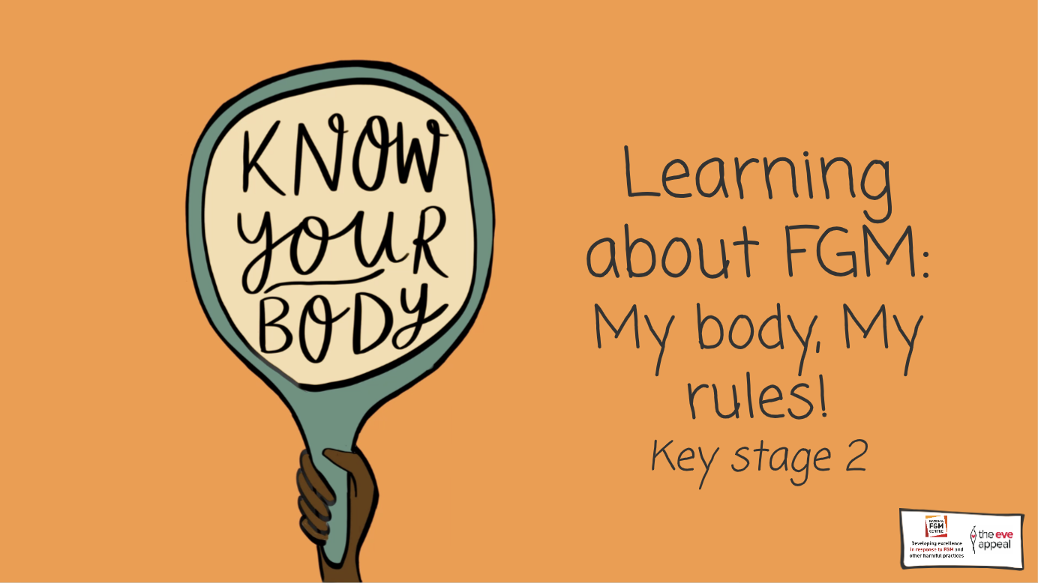

Slide 2
Notes:
In this lesson, we will be exploring growing up, how the body changes naturally, and that it should not be harmed or changed. We will also be discussing something called FGM. Does anyone know what that stands for?
2-3 min
Teacher to encourage feedback by asking what each individual letter might mean. Teacher to end activity by saying it stands for Female Genital Mutilation, which will be explored a little later in the lesson.

Slide 3
Notes:
Before we start to talk about this very important topic, it’s important that we establish a class agreement
1 min
Teacher to suggest some class agreements including;
Feeling safe – if anything spoken about upsets a student or makes them feel anxious; they must speak to either a teacher in the room or another trusted adult
Teacher to ask whether students would like to add any other agreements

Slide 4
Notes:
Human bodies are amazing

Slide 5
Notes:
There are so many different parts that make up the human body

Slide 6
Notes:
Bodies with male and female parts have parts that are the same

Slide 7
Notes:
Like the stomach, heart, and brain
2-3 min: Teacher to ask class if they can name any other parts of the body

Slide 8
Notes:
And some parts which are different – like the private parts

Slide 9
Notes:
In females, this part here is called the vulva, whereas in males, it’s called the male genitalia

Slide 10
Notes:
This bit is called the vulva = it’s pronounced vul-va

Slide 11
Notes:
The vulva is made up of ‘lips’ called labia

Slide 12
Notes:
Bodies with female parts have three holes.

Slide 13
Notes:
The vagina, for menstruation, reproduction and childbirth, the anus, where faeces or poo will come out from, and the urethra where urine comes out from

Slide 14
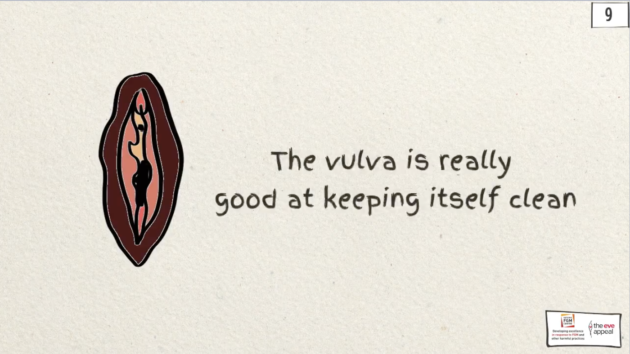
Notes:
The vulva is really good at keeping itself clean

Slide 15
Notes:
The male genitalia is made up of the penis, for reproduction and where urine comes out from, the urethra, where pee comes from and testicles, which produce hormones and sperm. Male bodies have 2 holes.

Slide 16
Notes:
Every vulva is different – and that’s perfectly fine - like the male genitalia too! There is no normal

Slide 17
Notes:
There are lots of different shapes and sizes

Slide 18
Notes:
As people grow up, their body will change, from baby to adult. Other than the body changing on its own, no one else has the right to purposely hurt or change anyone else’s body, as this would go against someone’s rights

Slide 19
Notes:
Ruby and Jack are now going to teach us all about what rights are

Slide 20
Notes:
Teacher to prompt students – rights in the home, rights in school, rights outside – do all children have these rights?
Teacher to prompt students – rights in the home, rights in school, rights outside – do all children have these rights?

Slide 21
Notes:
Activity: We are now going to do an activity of labelling the different parts of the body – like some of the parts we have already seen
Teacher to provide support and prompts to students to label parts of the body that both can and cannot be seen
1-2 min activity:
Now that students have labelled various parts of the body, ask what would happen if various parts of the body were removed? E.g., if the nose were removed, a person could not smell, or if the ears were removed, a person could not hear
Encourage and praise good feedback

Slide 22
Notes:
We have spoken about children’s rights - what are body rights?
Teacher to gather feedback

Slide 23
Notes:
Body rights are about someone’s right to make decisions about their own bodies

Slide 24
Notes:
Every child has the right to be protected from being hurt and mistreated, in body or mind

Slide 25
Notes:
Everyone’s body belongs to them

Slide 26
Notes:
Nobody has the right to touch or hurt anyone else’s body

Slide 27
Notes:
Jack and Ruby shared that rights are what every child needs to live a happy and healthy life.

Slide 28
Notes:
This includes removing any part of someone's body, like the body parts we labelled in the activity. However, sometimes, people’s rights are not respected

Slide 29
Notes:
For example, there is something called FGM – does anyone know what that is?
Teacher to gather any feedback including where students may have learnt about it from

Slide 30
Notes:
FGM is Female Genital Mutilation. Female means girl, genital means the private parts, and mutilation is when something is removed or injured.
Teachers should be alert to any reactions from students from this point

Slide 31
Notes:
So female genital mutilation is where some parts of a girl’s private area are removed or injured

Slide 32
Notes:
FGM is wrong, because it can cause harm and goes against a girl’s rights to be safe

Slide 33
Notes:
We know that much like every part of the female body, the private parts have an important job to play – so they must not be hurt or removed

Slide 34
Notes:
And as we know from Ruby and Jack, no one else has the right to hurt or change anyone else’s body, as this would go against someone’s rights

Slide 35
Notes:
FGM is not allowed (illegal) in the UK – it’s also not allowed for girls to be taken out of the country to have FGM, because it would hurt them

Slide 36
Notes:
FGM happens all over the world and is against a girl or woman's body rights - it can cause lots of harm

Slide 37
Notes:
So what should someone do if they were worried about this?
Teacher to go through what students can to do seek support

Slide 38
Notes:
It’s always okay to seek support - someone is always there to help

Slide 39
Notes:
10 min
Activity part 1: Ruby and Jack taught us all about children’s rights. In pairs, discuss what 3 rights all children have
Prompt questions: What are body rights everyone has? Name one right you have at home and one at school

Slide 40
Notes:
Activity part 2: If Ruby and Jack were here now, what could we teach them about FGM?
Prompt questions: Is it against children's rights? Does it cause harm? Is it not allowed? Who can people turn to for help?
Teacher to hand out certificate of achievement for learning about such an important topic

