Slide 1
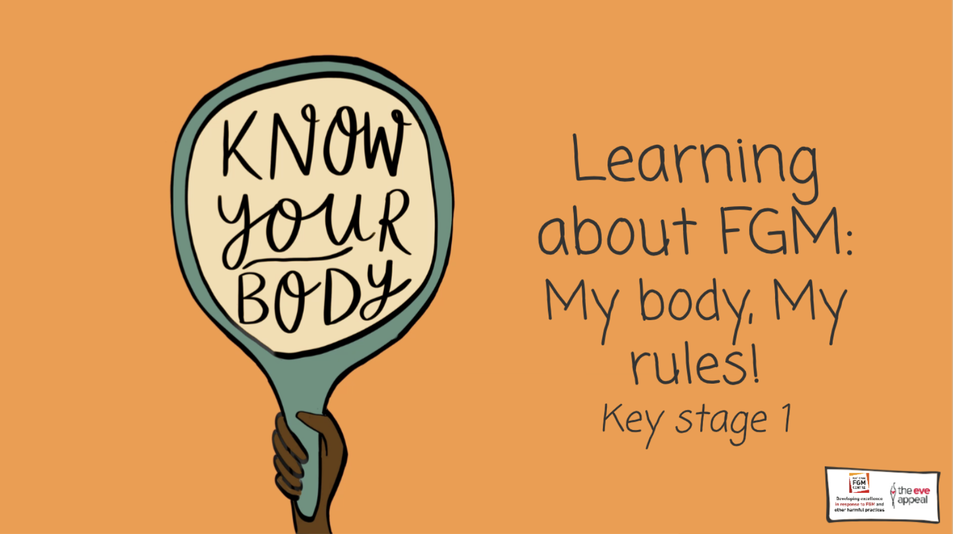

Slide 2
Notes:
Guidance: This lesson explores growing up, how the body changes naturally, and that it should not be harmed. It will also explore FGM. Does anyone know what that stands for?

Slide 3
Notes:
Before we start to talk about this very important topic, it’s important that we establish a class agreement

Slide 4
Notes:
Human bodies are amazing

Slide 5
Notes:
There are so many different parts that make up the human body

Slide 6
Notes:
Like the eyes, noses, hands, and lots of organs on the inside too

Slide 7
Notes:
Like the stomach, heart, and brain
2-3 min: Teacher to ask class if they can name any other parts of the body

Slide 8
Notes:
Bodies with male and female parts have parts that are the same

Slide 9
Notes:
And some parts which are different – like the private parts

Slide 10
Notes:
Let’s have a think about how human bodies change, from babies to adults
Activity: Teacher to encourage students to think about how the body changes throughout a person’s life
Teacher to hand out activity sheet titled: ‘How does the body change throughout a person’s life?’
- Label what babies can do, can’t do, and what they might need help with e.g., they can eat, but require an adult to help them things
- Label what children can do, can’t do and what they might need help with, as well as how the body has changed since it was a baby e.g., they can now walk and run, as well as talk and eat independently. They might also be taller, have more hair etc.
- Label what adults can do, can’t do and what they might need help with, as well as how the body has changed since it was a child e.g., an adult might grow stronger, women might have babies etc.
Teacher to spend 1 minute gathering feedback

Slide 11
Notes:
As a person grows up, their body will change, just like it has since they were a baby. Other than the body changing on its own, no one else has the right to hurt or change anyone else’s body, as this would go against someone’s rights

Slide 12
Notes:
Were now going to watch a video, where Ruby and Jack are going to teach us all about children's rights
5 min – Teacher to play UNICEF video – what are child rights?
3-4 min
Activity - What other rights do all children have?
Teacher to prompt students – rights in the home, rights in school, rights outside – do students think all children have these rights?

Slide 13
Notes:
Jack and Ruby shared that rights are what a person needs to live a happy and healthy life

Slide 14
Notes:
However, sometimes, people’s rights are not respected

Slide 15
Notes:
Now, we need to discuss something very important – and that’s called FGM – does anyone know what that is?

Slide 16
Notes:
FGM is Female Genital Mutilation. Female means girl, genital means the private parts, or the vulva, and mutilation is when something is removed or hurt

Slide 17
Notes:
So female genital mutilation is where some parts of a girl’s private area, the vulva, are removed or injured
Teachers should be alert to any reactions from students from this point

Slide 18
Notes:
FGM is wrong, because it can cause harm and goes against a girl’s rights to be safe – just like Jack and Ruby said

Slide 19
Notes:
And because of this, it isn’t allowed in the UK – it’s illegal

Slide 20
Notes:
So what should someone do if they were worried about this?
Teacher to go through what students can to do seek support

Slide 21
Notes:
It’s always okay to seek support - someone is always there to help
10 min: Activity - put students into pairs/groups to discuss: a friend is worried about FGM. Discuss where they could go to seek support.
Teacher Guidance: guide the discussion around this question - what are some helplines they can contact? Who are trusted adults they could go to?
Go around to each table encouraging conversations and prompting answers

Slide 22
Notes:
Group activity to end lesson: If Ruby and Jack were here, what could we teach them about FGM?
Prompt questions: Is it against children's rights? Does it cause harm? Is it not allowed? Who can people turn to for help?

