Slide 1
Nobody Changes MY Body!

Slide 2
Today’s Plan
We are going to learn about;
Growing up
and
Staying Safe

Slide 3
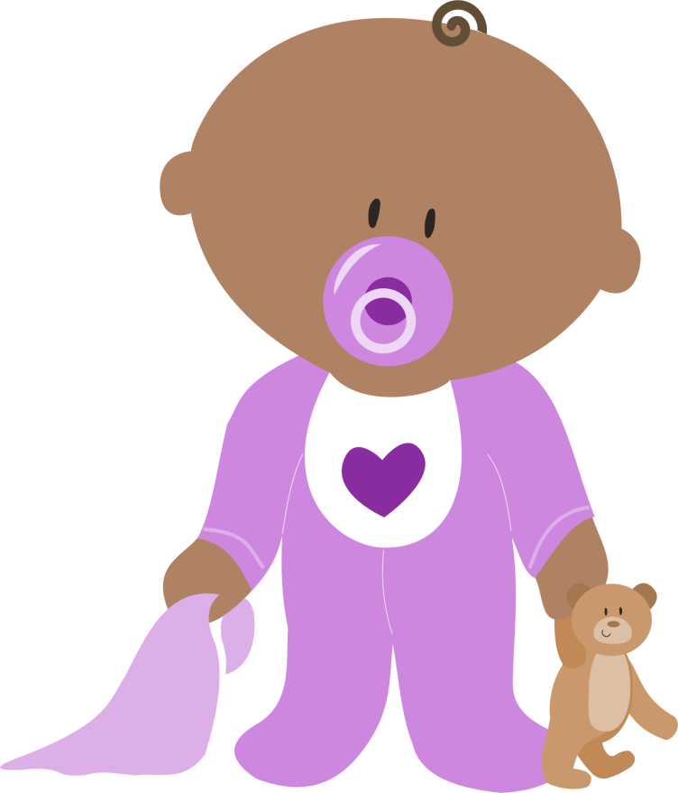
What can you do now?
How has your body changed since you were a baby?
Who helps and supports you now?
Draw a picture of you as a baby

Slide 4
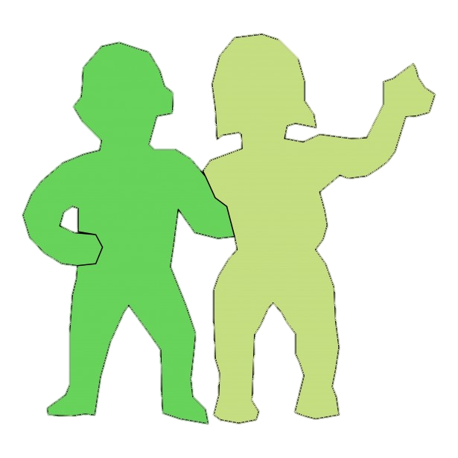
What can you do now?
How has your body changed since you were a baby?
Who helps and supports you now?
Draw a picture of you now

Slide 5
What will you be doing?
How will your body changed?
Who will help and support you in the future?
Draw a picture of you in the future

Slide 6
My rights
My body is MINE
Nobody has the right to HURT my body
Nobody has the right to CHANGE my body

Slide 7
FGM is…
when a girls private parts (genitals) are cut away or damaged
FGM is…
very painful and goes against children’s rights

Slide 8
FGM is…
Illegal!
Harmful to a girls health!

Slide 9
How has learning about FGM made you feel?

Slide 10
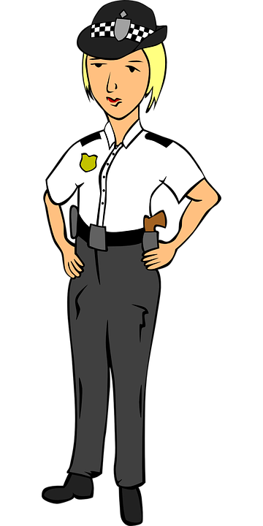
What should I do if I am worried?
999
NSPCC Helpline
Trusted Adult

Slide 11
Questions?

