Slide 1
Female Genital Mutilation/Cutting (FGM)
Duncan Kerr, Commissioning Manager VAWSADV, Powys County Council
Gail Morris, Clinical Health Practitioner, LAC, Powys Teaching Health Board

Slide 2
Aim:
To understand FGM as a form of child abuse and to be better able to identify and respond to it.

Slide 3
Objectives:
To understand the practice and context of FGM and the consequences of it for victims/survivors.
To become aware of the risk factors to look-out for.
To be able to explain the law & Powys procedures in relation to FGM.
To consider the practice and cultural issues of FGM.
To know where to go to for more advice and information

Slide 4
FGM/FC/FGC
Female Genital Mutilation: term used to make it clear that it is a very damaging violation of human rights.
Female Circumcision: term often used in practising countries felt to be misleading as it suggests a similarity to the much less damaging male circumcision.
Female Genital Cutting: term used by some who feel that the word “mutilation” stigmatises practising communities and/or survivors.

Slide 5
Honour Based Violence/ Crimes of Control.
Blackmail
Acid Attacks
Female Genital Mutilation
Blood Feuds
Honour Killings
Domestic Abuse
Forced Marriage

Slide 6
FGM.
Raises strong emotions.
For hundreds of years a hidden issue with little public knowledge or discussion.
This session may raise some uncomfortable issues.
Keep yourself safe, look after each other.

Slide 7
Sharing a secret
In groups of 5
Write down something about yourself that others may not know
Put the papers face down on the table.
Pick one (if its your own put it back!)
Try to decide which person in the group wrote it.

Slide 8
In which Countries is FGM Practiced?

Slide 9
Nationalfgmcentre.org.uk

Slide 10
FGM in the UK: Estimate of prevalence of FGM per 1,000 women in the population.

Slide 11
FGM in the UK: Estimated % of maternity to women with FGM

Slide 12
Powys compared: Prevalence of FGM per 1,000 women in the population.
Powys | 0.1
Monmouth | 0.2
Merthyr Tydfil | 0.3
Carmarthenshire | 0.2
Ceredigion | 0.7
Cardiff | 8.6

Slide 13
Powys compared: Maternities to women with FGM.
Powys | 0.15%
Wrexham | 0.08%
Monmouth | 0.12%
Merthyr Tydfil | 0
Carmarthenshire | 0.02%
Ceredigion | 0.06%
Cardiff | 3.19%

Slide 14
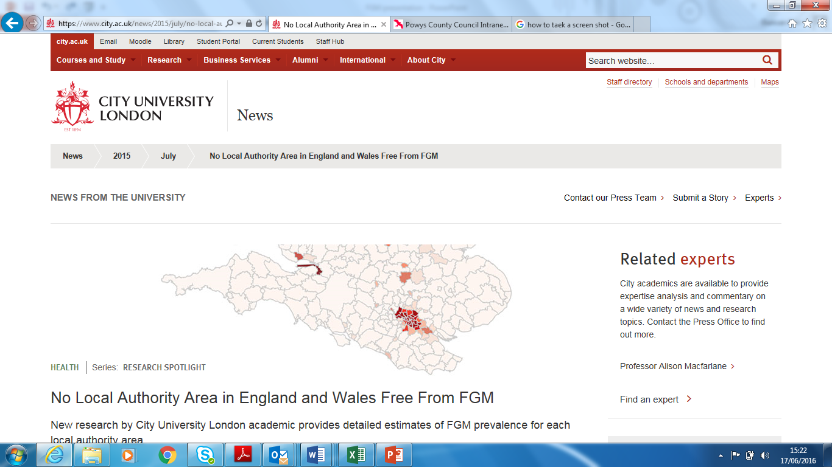

Slide 15
Implications – Prof Macfarlane
“Women who have undergone FGM are living in virtually every part of England and Wales”
You may not have come across a family from a country that practices FGM yet, but it might be your next case.
Because of their isolation from peer support children in such families could be more at risk in Powys so we have to be prepared and vigilant.
Ethnicity of the mother may not be the determining factor in risk of FGM.

Slide 16
The practice of FGM
https://www.youtube.com/watch?v=yOisuvepL0o&list=PLG8IrydigQfcOZJVitbBEAHtJL0T7I7_H&index=14
(To 7.00)

Slide 17
What do you feel about what you have just seen?

Slide 18
Who is at risk?
2 million girls around the world every year are mutilated
20,000 girls are at risk of FGM within the UK every year
Age for FGM can be from birth to marriage or beyond.
Practised by Muslim, Christian and Jewish communities
Practice started in the 5th BC.
Notes:
FGM is practised in 28 African Countries including Egypt
Also in parts of the Middle East, including Yemen, Syria and some Kurds in Northern Iraq
In Asia – some parts of Pakistan and Indonesia
The age at which FGM is performed varies – it depends on the ethnic group and geographical location.
Can be during infancy – from a few days old
During childhood – 4-10 years
At the onset of Puberty
At marriage
During 1st pregnancy

Slide 19
WHO Classification of FGM
Type I – Clitoridectomy
Partial or total removal of the clitoris and/or the prepuce.
Type II – Excision
Partial or total removal of the clitoris and the inner labia, with or without excision of the outer labia.
Type III – Infibulation
Narrowing of the vaginal opening by creating a covering seal.
Type IV – Other
All other harmful procedures to the female genitalia for non-medical purposes, e.g., pricking, piercing, incising, scraping and cauterising (burning) the genital area. Including tattooing.

Slide 20
Suggested reasons for FGM
Tradition
Culture
Family honour
Social acceptance and standing within the community, bringing status and respect to the girl
Perceived religious obligations
Chastity as a requirement of eligibility for marriage
Curbing a woman’s sexuality
Rite of passage/part of becoming a woman.
Notes:
Published reports and experts working in the area suggest that the reasons underlying the practice of FGM include:

Slide 21
(More) suggested reasons….
Hygiene/belief that it makes a woman ‘clean’
Belief that it makes sexual relations safer/more pleasurable for men.
Social conditioning
Misinformed beliefs regarding fertility and childbirth, including that it makes childbirth safer
Superstition and myth.
Notes:
One Imam said:
“One circumcises for protection. When a girls honor is locked away like the precious commodity it is – a thief cannot get to it. It prevents dangerous situations from occurring” He’s talking about rape here!
“Mothers do it out of love – safeguarding their daughters future for example their marriage prospects”
You Tube UNICEF video
Girls are regarded as having been cleansed by the removal of "male" body parts. It ensures pre-marital virginity and inhibits extra-marital sex, because it reduces women's libido. Women fear the pain of re-opening the vagina, and are afraid of being discovered if it is opened illicitly.
A girl may be opened and closed several times due to childbirth or marital sex.

Slide 22
FGM: The myths that sustain it.
The clitoris is dangerous and must be removed for health reasons.
Men can become impotent if in contact with the clitoris.
FGM prevents vaginal cancer.
An unmodified clitoris can lead to masturbation or lesbianism.
FGM makes a women’s face more beautiful.
Notes:
Boyle writes that the Masai of Tanzania will not call a woman "mother" when she has children if she is uncircumcised.
According to Amnesty, in certain societies women who have not had the procedure are regarded as too unclean to handle food and water
There is a belief that a woman's genitals might continue to grow without FGM, until they dangle between her legs.
Some groups see the clitoris as dangerous, capable of killing a man if his penis touches it, or a baby if the head comes into contact with it during birth, though Amnesty cautions that ideas about the power of the clitoris can be found elsewhere.
Gynaecologists in England and the United States would remove it during the 19th century to "cure" insanity, masturbation, and nymphomania.
The first reported clitoridectomy in the West was carried out in 1822 by a surgeon in Berlin on a teenage girl regarded as an "imbecile" who was masturbating.
Isaac Baker Brown (1812–1873), an English gynaecologist who was president of the Medical Society of London in 1865, believed that the "unnatural irritation" of the clitoris caused epilepsy, hysteria, and mania, and would remove it "whenever he had the opportunity of doing so," according to an obituary.

Slide 23
FGM: The Real Reason
Power, Control and Subjugation

Slide 24
FGM health implications
SHORT TERM
Shock
Haemorrhage
Trauma
Infection
Urinary Retention
Possible transmission of HIV
Fracture or dislocation to limbs as a result of restraint
LONG TERM
Implantation cysts
Keloid scar formation
Dysuria
Surgery to achieve intercourse
Dyspareuria
Psycho – social
PID/infertility
Dysmenorrhoea
Vaginal Infection
Death
Notes:
Girl/woman will be traumatised for life.
Child abuse – physical abuse + massive psychological abuse
She will remember smells, the number of people who were present, instruments used, pain etc.
Depends of type of FGM and methods used
Dysmenorrhoea – interruption of the natural menstrual cycle
PID – pelvis inflammatory disease
Dyspareuria – difficult or painful intercourse
Dysuria – painful & difficult urination
Keloid scar – tough heaped up scar
Implantation cysts – lump under the skin

Slide 25
FGM Implications in Pregnancy
Difficulty in vaginal examinations
Delay in descent of head
Flashbacks
Fistulas
Perineal damage
Haemorrhage
Foetal or maternal death
Notes:
Fistula
A fistula is an abnormal connection between 2 body parts, such as an organ or blood vessel and another structure. Fistulas are usually the result of an injury or surgery. Infection or inflammation can also cause a fistula to form.
Perineal Damage
Tearing during childbirth

Slide 26
Law on FGM

Slide 27
It is an Offence under the FGM Act 2003 to:
Perform FGM in the UK or take a girl abroad to be subjected to FGM
Assist the carrying out of FGM in the UK or abroad;
Assist from the UK a non-UK person to carry out FGM outside the UK on a UK national/permanent UK resident.
For someone in the UK to aid, abet, counsel or procure FGM outside of UK.
Notes:
The penalty is up to 14 years imprisonment.
For section 1, it is an offence for UK national to carry out FGM outside of the UK, and also to aid, abet counsel or procure. EG if a person in the UK advises his UK national brother over the phone how to carry out and FGM operation abroad, he is guilty of the offence
Section 2, it is an offence for a UK national or permanent UK resident outside the UK to aid, abet counsel or procure a person of any nationality to carry out FGM on herself wherever the procedure is carried out.
So for Section 3, it is an offence for a UK national or permanent UK resident outside the UK to aid, abet, counsel or procure a foreign national (who is not a UK resident) to carry out FGM outside the UK on a UK national or permanent UK resident. EG a permanent UK resident who takes his permanent UK resident daughter to the doctor’s surgery in another country so that FGM can be carried out is guilty of an offence
Section 4 of the act extends sections 1,2, and 3 so that any of the prohibited acts done outside of the UK by a UK national or permanent resident will be an offence under domestic law and will be triable in the courts of England and Wales. (in Scotland the 1985 act continues to apply)

Slide 28
The Serious Crimes Act 2015
Extend extra-territorial jurisdiction for FGM,
Provides anonymity for victims of FGM,
Create a new offence of failure to protect a girl from FGM,
Introduce FGM protection orders,
Introduce a mandatory reporting duty requiring regulated health and social care professionals to report known cases of FGM in under 18s to the police
Confers on the secretary of state a power to issue statutory guidance on FGM
Notes:
extra territoriality has been extended to those habitually resident in UK, could we also add that mandatory reporting is within 28 days

Slide 29
Who can apply for an FGM Protection Order?
The girl or women to be protected.
A Relevant Third Party (RTP) appointed by the Lord Chancellor. Local Authorities are relevant third parties; or
Any other person with the permission of the court (this could be the police, a voluntary sector support service, a healthcare professional, a teacher, a friend or family member).

Slide 30
What can be imposed?
For example a court might order:
that a person surrender his or her passport or any other travel documents and/or the passport of the girl/woman to be protected to prevent them from taking the girl or woman at risk abroad with the purpose of committing FGM;
Notes:
A court can impose prohibitions, requirements and restrictions, the aim of which are to protect the girl or woman at risk.
An FGM Protection Order can also include terms which relate to conduct which occurs both within and outside of England and Wales. For example, it is an offence for an individual to arrange, by telephone from their home in England, for their UK national daughter to have an FGM operation carried out abroad by a foreign national (who does not habitually live in the UK). The terms of the Order can also cover other persons who are involved, or who may become involved, as well as named respondents.

Slide 31
Practice Issues: FGM Protection Orders and Safeguarding
A child subject to an FGM Protection Order is highly likely to also be on the CP register.
It is possible that the child will remain on the register until they are 18, which could be over a decade later.
It may also be the case that the threat of FGM is the only safeguarding concern that the Local Authority has.

Slide 32
Mandatory Recording and Reporting
Mandatory Recording is in regard to adult women and is a matter for Health Professionals such as GPs.
As a result of the Serious Crimes Act 2015, mandatory reporting is required under Section 5B of the FGM Act 2003. It concerns children under 18 and is a matter for all regulated professions (health, social care and education)

Slide 33
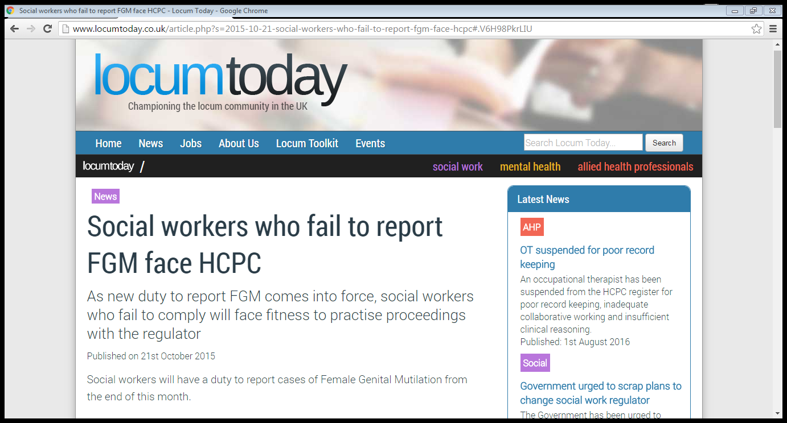

Slide 34
Mandatory Reporting: “Known” Cases
All regulated health and social care professionals have to report direct to the Police any child under 18 where:
as a result of examination FGM has been visually identified.
they disclose that they have had FGM.
“You are not required to ‘verify’ that FGM has occurred in order for the duty to apply and a report to be made”.
The duty is personal; i.e. the professional who identifies FGM/receives the disclosure must make the report it cannot be transferred.

Slide 35
Mandatory reporting does not apply to:
An adult woman (18+) discloses that she has had FGM
Parent/guardian discloses that her child has had FGM
You believe a girl is at risk of FGM
You think a girl might have had FGM but she has not disclosed, and you have not seen any signs/symptoms
If you know it has already been reported by a regulated professional in your organisation.
IN THESE CASES YOU NEED TO FOLLOW LOCAL SAFEGUARDING PROCEDURES

Slide 36
What is a verbal disclosure under Section 5B of the FGM Act 2003?
“A girl under 18 discloses that she has undergone FGM using all accepted terminology”.
Implications are that you need to know the local terms she might use.

Slide 37
Local terms for FGM

Slide 38
Local terms for FGM

Slide 39
When to Report?
Statutory guidance states “as soon as possible and in any event by the end of the next working day.
FGM Act 2003 allows for reporting up to one month afterwards in “exceptional cases”, in this case a record of the reasons will need to be kept.
May not always be possible to seek management advice before reporting.
The duty is personal it cannot be delegated, or taken up by, another person.

Slide 40
How to Report to?
By phoning the Police on 101
Making a full and detailed record on the IT system
Alerting your senior manager and safeguarding lead officer.

Slide 41
When you phone 101 be prepared to..
Explain that you are making a report under the FGM mandatory reporting duty
Provide your name, contact details, times when you will be available to be called back, your role and place of work
Provide details of your organisation’s designated safeguarding lead (Name, contact details (work telephone number and e-mail address) and place of work
Provide the girl’s details (name, age/date of birth, address)
Confirm that you have undertaken, or will undertake, safeguarding actions, as required by the All Wales Procedures.

Slide 42
Failure to Report
It’s been the law since Oct 2015.
Failure to comply may be considered through existing Fitness to Practise proceedings with your regulator
Regulators will, as with all other matters, consider professionals ability currently to practise safely and take into account the circumstances of the case.
Implications are serious for you, may be even more serious for other children in the family.

Slide 43
Practice Issues: Informing Parents?
“In line with safeguarding best practice, you should contact the girl and/or her parents or guardians as appropriate to explain the report, why it is being made, and what it means. Wherever possible, you should have this discussion in advance of/in parallel to the report being made. Advice and support on how to talk to girls and parents/guardians about FGM is available in the multi-agency guidance on FGM.
However, if you believe that telling the child/parents about the report may result in a risk of serious harm to the child or anyone else, or of the family fleeing the country, you should not discuss it”.

Slide 44
Practice Issues: Reporting FGM and trust of young person
Statutory guidance says:
“The FGM mandatory reporting duty is a legal duty provided for in the FGM Act 2003 (as amended by the Serious Crime Act 2015). If the duty applies to you and you identify a relevant case, you are legally required to make a report to the police.
There may be situations where this is difficult, but you are advised to be open and honest, in line with best practice on information sharing and safeguarding”.

Slide 45
Practice Issues: Cultural Barriers:
People from countries where FGM is widely practiced:
may be “fearful” of authorities (for good reason).
may not see FGM as abuse.
may not understand the concept of “safeguarding” (SAWN, 2015).
may not know it is unlawful.
Women who may appear to be the perpetrators, are almost inevitably victims themselves.

Slide 46
Practice Issues: Signs that FGM may be about to take place.
The family come from a community that is known to practise FGM
Parents state they will take the child out of the country for a prolonged period
A girl may talk about a long holiday to a country where the practice is prevalent
A girl may confide that she is to have a special ceremony or celebration.
Notes:
Professionals in all agencies and individuals and groups in the community need to be alert to the possibility of a child being at risk of, or having experienced FGM.
These are a short list of potential indicators that a child may be at risk of FGM, which individually may not indicate risk, but if there are 2 or more present this could signal a risk to the child.

Slide 47
Practice Issues: Signs that FGM may have already taken place.
A girl may spend long periods of time away from the classroom during the day with bladder or menstrual problems.
Prolonged absences from School plus a noticeable behaviour change.
A girl requiring to be excused from physical exercise without the support of their GP.
Notes:
The child may confide in a professional or may ask for help
Again this is not an exhaustive list, and no indicator should be taken in isolation
Any female child born to a woman who has been subjected to FGM must be considered to be at risk, as must other female children in the extended family
Any female child who has a sister who has already undergone FGM must be considered to be at risk, as must other female children in the extended family.

Slide 48
Video Clip
https://www.youtube.com/watch?feature=player_embedded&v=kzBNTtR7toE

Slide 49
Exercise on Mandatory Reporting
Hand-out to be completed in groups.

Slide 50
Help and Advice: Powys

Slide 51
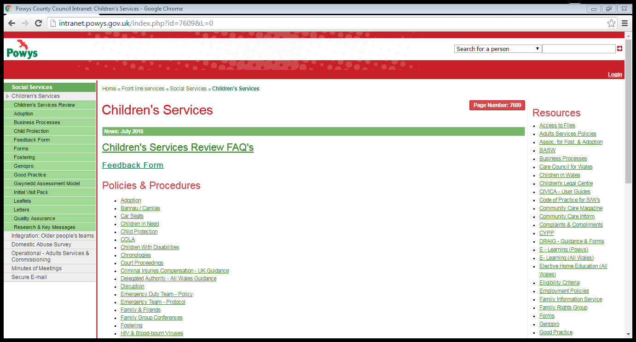

Slide 52
Statutory Help and Advice: UK

Slide 53
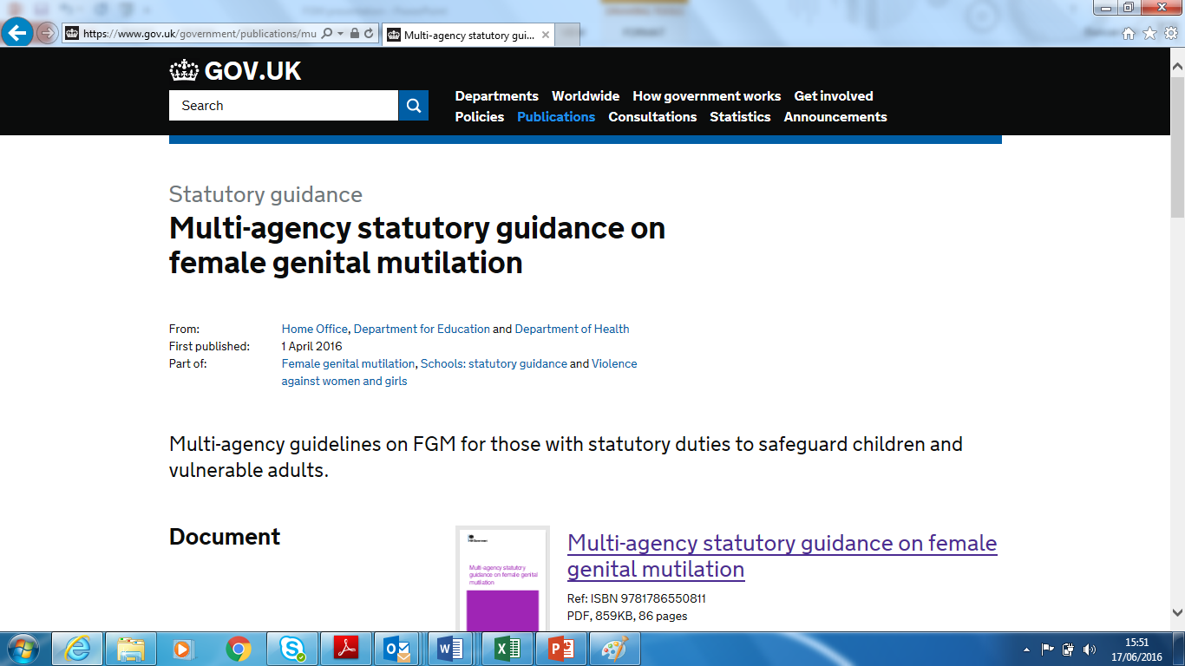

Slide 55
Statutory Help and Advice: Wales

Slide 56
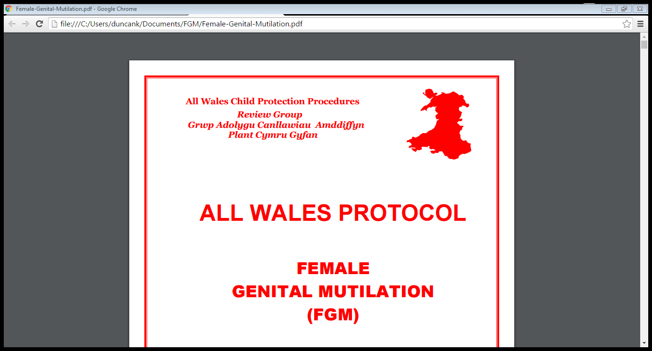

Slide 57
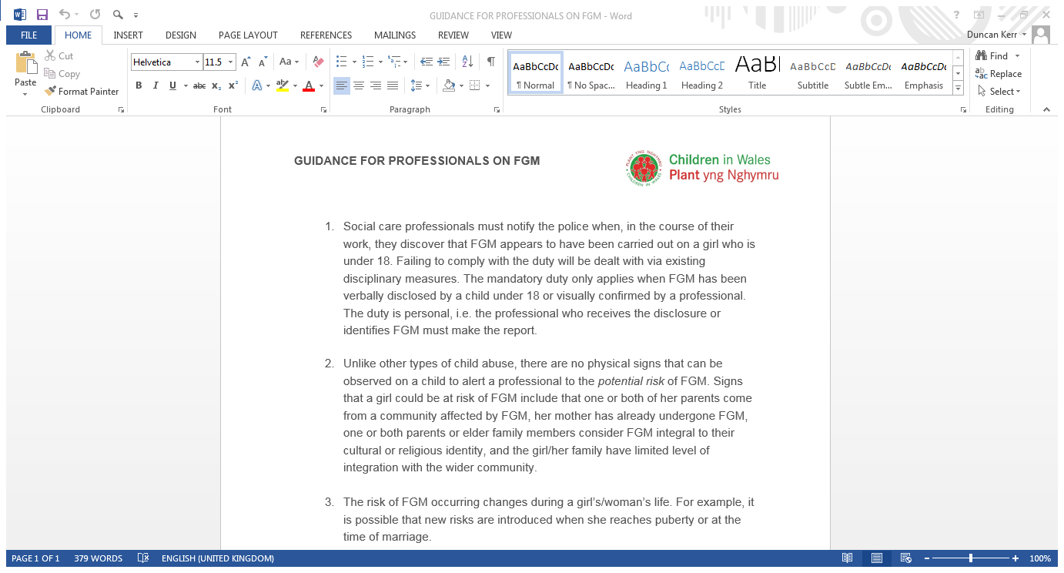

Slide 58
Other Help and Advice
Further CPD learning available from the Home Office: www.fgmelearning.co.uk
Excellent material to build on this course.

Slide 59
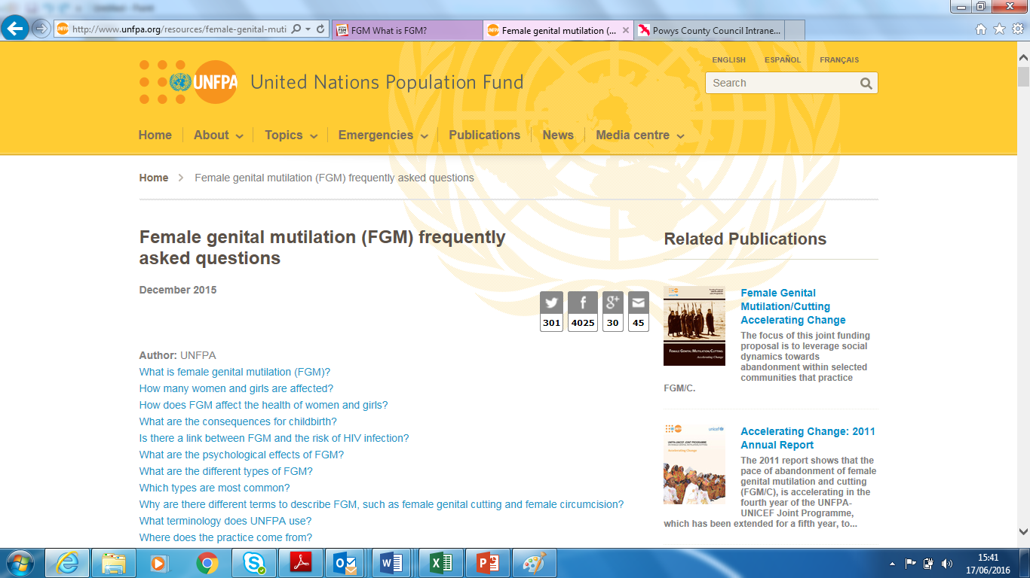

Slide 60
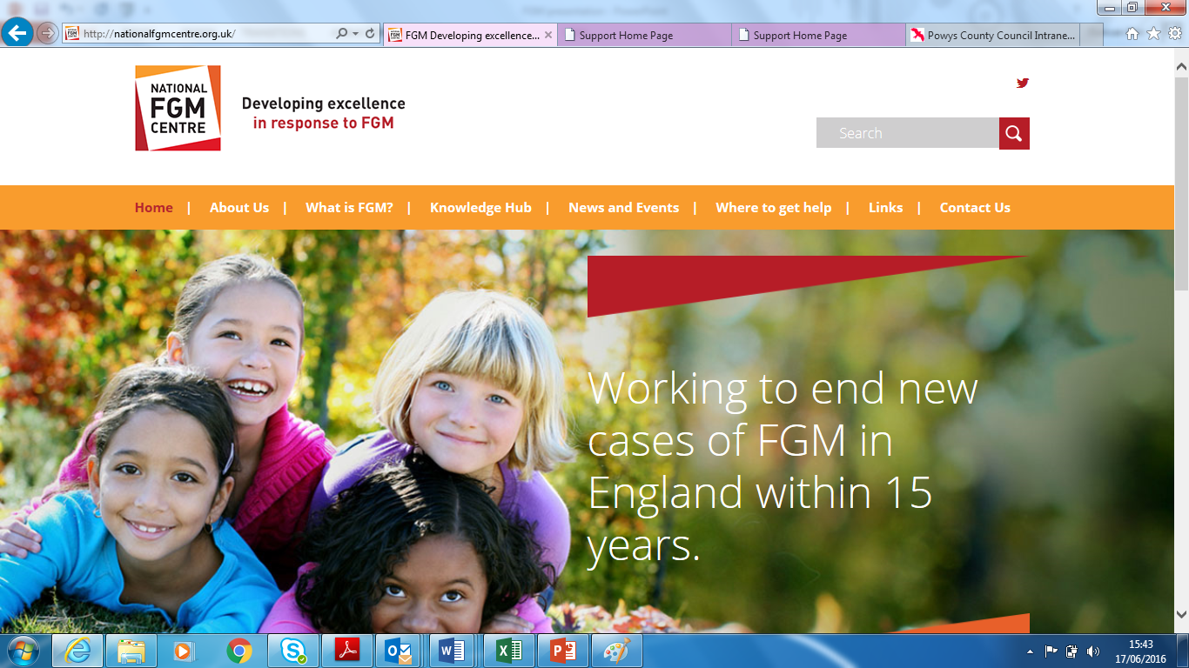

Slide 61
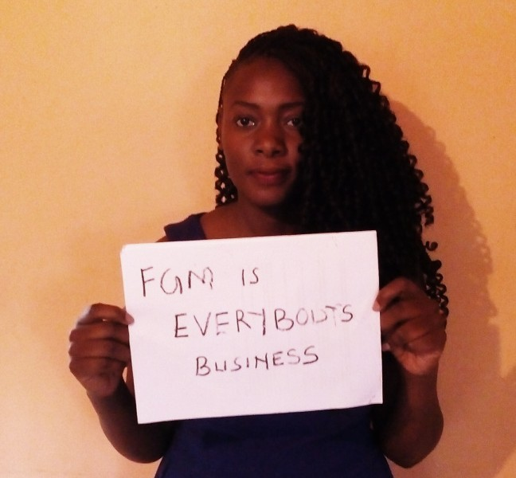

Slide 62
Recap on Objectives:
To understand what FGM is, the context in which it is practised and the consequences of it for victims/survivors.
To become aware of the risk factors in practice
To be able to explain the law on FGM & Powys procedures in relation to FGM.
To consider the practice and cultural issues.
To know where to go to for more advice and information

Slide 63
Very Many Thanks for Participating
Hope you have found the session relevant and interesting
Please fill in the feed-back sheet so we can improve it in the future

