Slide 1
FGM Introduction
for young people

Slide 2
Ground Rules 🤝

Slide 3
Objectives
To gain a awareness of how to keep yourself safe.

Slide 4
Body Rights and Body Safety 👤

Slide 5
Questions
Have you heard about FGM?
What do you know about FGM?

Slide 6
What is FGM?
" "Female Genital Mutilation - also called FGM, female circumcision, cutting or sunna - is when a girl's external genitals (private parts) are cut away"
Childline, NSPCC FGM Definition

Slide 7
Other terms for FGM

Slide 8
Female Genitalia

Slide 9
Female Genitalia
This is what uncut genitalia looks like!
In FGM, the clitoris may be removed or part of the vulva may also be removed.
Sometimes, in extreme cases, the vagina is also closed up.

Slide 10
Female Genitalia
Would you like to see the different types of FGM?
If not, skip the next slide.

Slide 11
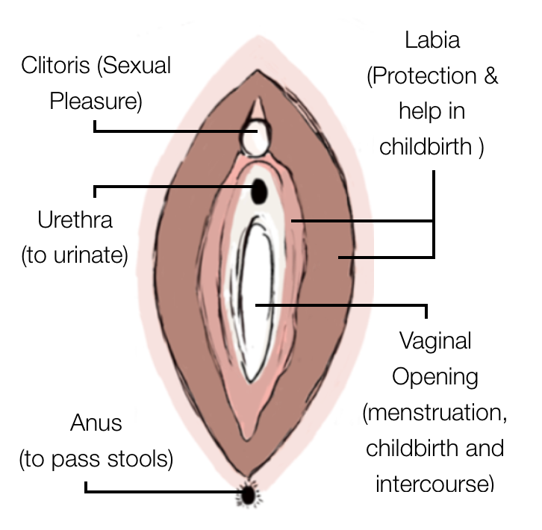
Types of FGM

Slide 12
Types of FGM
Type 4 FGM
Other: all other harmful procedures to the female genitalia for non-medical purposes, e.g. pricking, piercing, incising, scraping, stretching and cauterising the genital area.

Slide 13
Facts
It has NO health benefits and
harms girls and women in many ways...

Slide 14
Facts
It VIOLATES girl's and women's rights and is against the UNCRC!

Slide 15
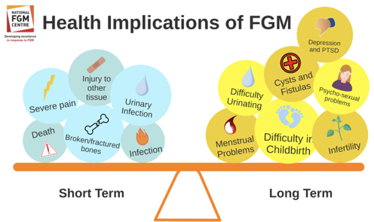
Potential Health Implications of FGM

Slide 16
Question
Why is FGM Practiced?

Slide 17
Why is FGM Practiced?

Slide 18
Why is FGM Practiced?

Slide 19
Facts

Slide 20
Question
Where is FGM Practiced?

Slide 21
Where is FGM Practiced?

Slide 22
Activity
Quiz

Slide 23
Question
Is FGM against the law?

Slide 24
The Law in England and Wales
It is illegal to..
Perform FGM on a girl in UK
Bring a girl outside of the UK to have FGM done on a habitual resident of the UK.
Aid the act of FGM in any way
Buying flights
Paying cutter etc.
Including:
- Asylum seeking families
- Families on student visa

Slide 25
The Law and protection

Slide 26
What to do if you are worried?
DO NOT STAY SILENT!
Call the NSPCC Helpline for advice, on 0800 028 3550.
If you a concerned that a friend you know may be at risk of FGM, speak to a trusted adult
If you or a girl you know are at immediate risk call the police on 999.

Slide 27
How do you feel now you have learn't about this? Do you have any questions? 🤔

Slide 28
What did you learn?

