Slide 1
FGM Introduction
for parent(s)/carer(s)

Slide 2
Ground Rules 🤝

Slide 3
Objectives
To gain a basic awareness of FGM
To understand that girls with disabilities are particularly vulnerable to FGM

Slide 4
Child Abuse
Physical
Emotional
Sexual
Neglect

Slide 5
Questions
Have you heard about FGM?
What do you know about FGM?

Slide 6
What is FGM?
"All procedures which involve the partial or total removal of the external genitalia or injury to the female genital organs whether for cultural or any other non-medical reasons"
The World Health Organisation

Slide 7
What is FGM?
FGM is child abuse.
Young girls between infancy and the age of 15 – most commonly between 6 and 8 years old.

Slide 8
Other terms for FGM

Slide 9
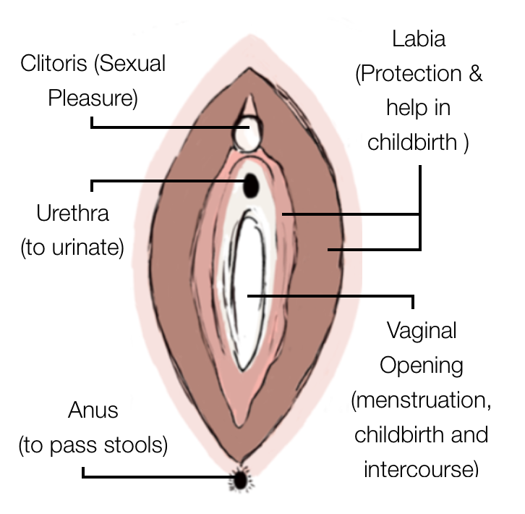
Types of FGM
Any other injury

Slide 10
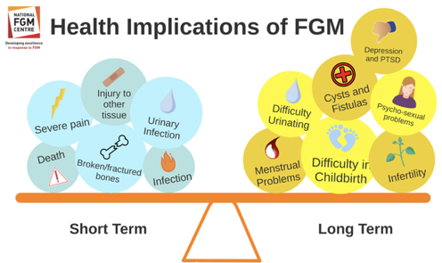
Potential Health Implications of FGM

Slide 11
Why is FGM Practiced?

Slide 12
Where is FGM Practiced?

Slide 13
The Law in England and Wales
It is illegal to..
Perform FGM on a girl in UK
Bring a girl outside of the UK to have FGM done on a habitual resident of the UK.
Aid the act of FGM in any way
Buying flights
Paying cutter etc.
Including:
- Asylum seeking families
- Families on student visa

Slide 14
Mandatory Reporting and Protection

Slide 15
Advice and Information
Call the National FGM Centre on 02084987137
Call the NSPCC Helpline on 0800 028 3550 for advice and support on FGM.
Download FGM Passport to show family or friends who may be putting pressure on you.
Call the police if you or a girls are in immediate danger.

Slide 16
Do you have any questions? 🤔

